Slide 1

SCHOOL OF ENGINEERING
DEPARTMENT OF COMPUTER SCIENCE & ENGINEERING
FACE RECOGNITION ATTENDANCE SYSTEM
By
Kata Nithin – 227Z1A0576
Lakkakula Bindu – 227Z1A0591
Kommarajula Praveen – 227Z1A0582
Under the Guidance of
Mr. S. Srikanth Reddy
(Assistant Professor)

Slide 2

Problem Statement
The “FACE RECOGNITION ATTENDANC SYSTEM” provides a contactless and automated solution for attendance management.

Slide 3
Literature Survey
S.No | Paper Title | Authors | Year | Methodology | Findings | Limitations
1 | Automated Attendance System Using Face Recognition | A. Sharma, B. Patel | 2020 | CNN-based facial recognition | Achieved 95% accuracy in controlled environments | Performance drops in low light conditions
2 | Real-Time Face Recognition for Attendance Using OpenCV | K. Singh, M. Verma | 2019 | OpenCV with Haar Cascade | Fast and lightweight implementation | Struggles with occlusions and angle variations
3 | IoT-Enabled Face Recognition for Smart Attendance | S. Das, L. Roy | 2022 | Raspberry Pi with cloud-based processing | Remote access and real-time monitoring | Requires stable internet connection
4 | Hybrid Model for Face Recognition Attendance System | J. Lee, T. Wong | 2023 | CNN + LBP for feature extraction | Improved accuracy under varied lighting | Increased processing time

Slide 4
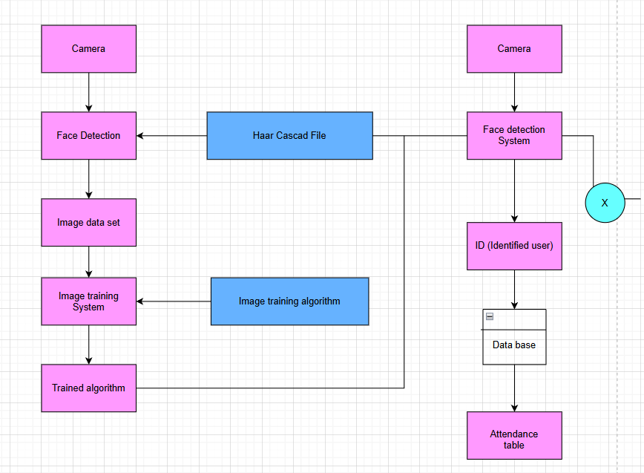
Existing System

Slide 5
Disadvantages
Privacy concern.
Cost and Infrastructure.

Slide 6
Proposed System
User Interface
(Tkinter)
Webcam Video Feed
(OpenCV)
Face Detection
(OpenCV - Haar/DNN)
Face Preprocessing
(Normalization, NumPy)
Face Recognition
(LBPH / ML Model)
Compare with Stored Encodings
(NumPy / Pickle)
Mark Attendance
(Pandas + DateTime)
Access Denied
(Tkinter Msg)
Export to CSV/Excel
(Pandas)

Slide 7
Advantages
1.Contactless and Efficient.
2.Accurate Tracking.
3.Security.
4.Time-Saving.
5.Real-Time Monitoring.

Slide 8
Software Requirements
1.Python IDLE 3.10
2.SQL lite
Hardware Requirements
1.Camera
2.Memory

Slide 9
MODULES
1. Data Collection and Preprocessing Module
💡 Purpose:
Collect, clean, and structure facial image data to prepare it for training the face recognition model.
✅ Responsibilities:
Import image datasets (e.g., captured images or images from databases).
Perform face detection and cropping from raw images.
Handle missing or low-quality images.
Normalize and resize facial images for uniformity.
Split the dataset into training, validation, and test sets.
🛠Tools Used:
Python libraries: OpenCV, pandas, numpy.

Slide 10
2. Feature Extraction Module
💡 Purpose:
Extract unique facial features from images for accurate recognition.
✅ Responsibilities:
Apply face embedding techniques (e.g., using FaceNet, Dlib, or DeepFace).
Convert images into feature vectors for model input.
🛠Tools Used:
Python libraries: OpenCV.
3. Attendance Management Module
💡 Purpose:
Automate attendance marking based on recognized faces.
✅ Responsibilities:
Detect and recognize faces in real-time using a camera feed.
Mark attendance and record it in a database or file system.
Generate attendance reports.
🛠 Tools Used:
Python libraries: OpenCV, pandas, SQL Lite

Slide 11
4. Face Recognition & Classification Module
💡 Purpose:
Train a machine learning model to recognize and classify faces.
✅ Responsibilities:
Train the model using extracted facial features.
Implement classifiers (e.g., SVM, KNN, or Deep Learning models).
Evaluate model accuracy and performance.
🛠Tools Used:
Python libraries: Open CV,Numpy
5. User Interface Module
💡 Purpose:
Provide a user-friendly interface for users to interact with the system.
✅ Responsibilities:
Design GUI for user registration, attendance view, and report generation.
Display real-time face detection and recognition.
🛠Tools Used:
Python libraries: Tkinter

Slide 12
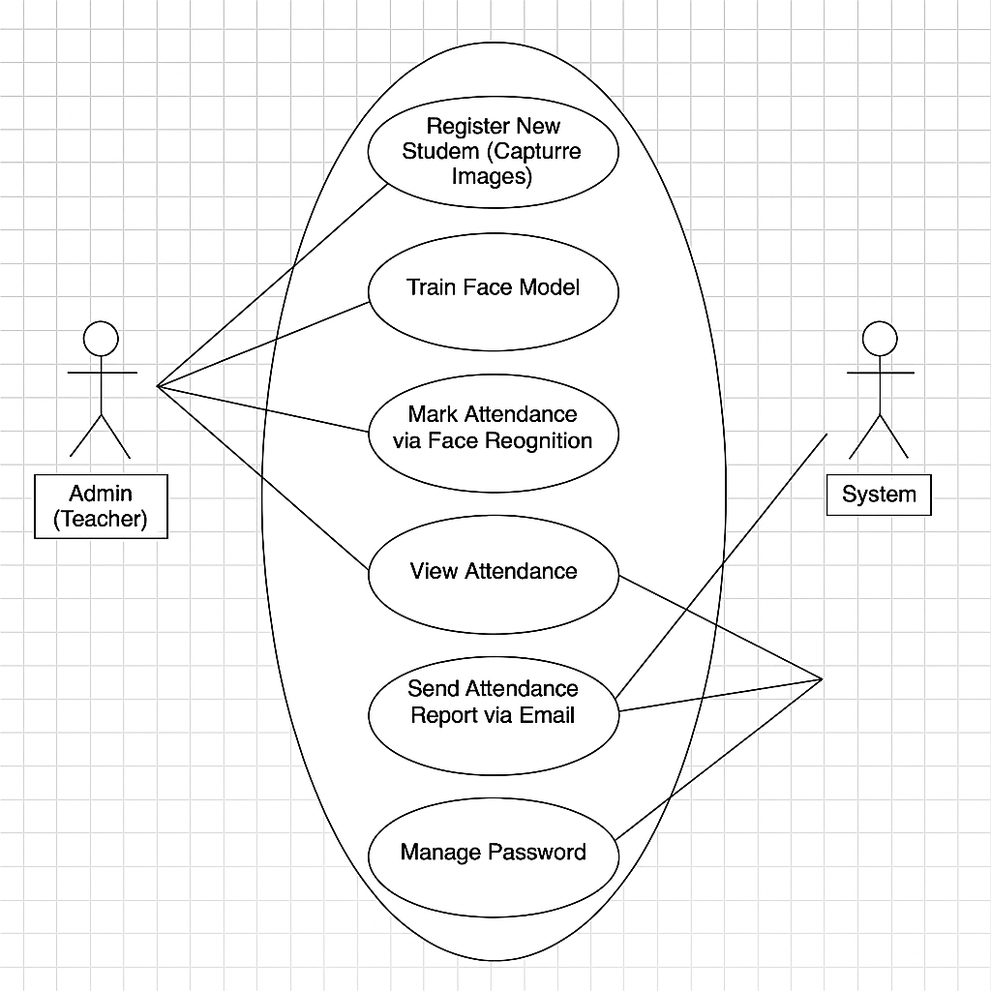
USE CASE DIAGRAM

Slide 13
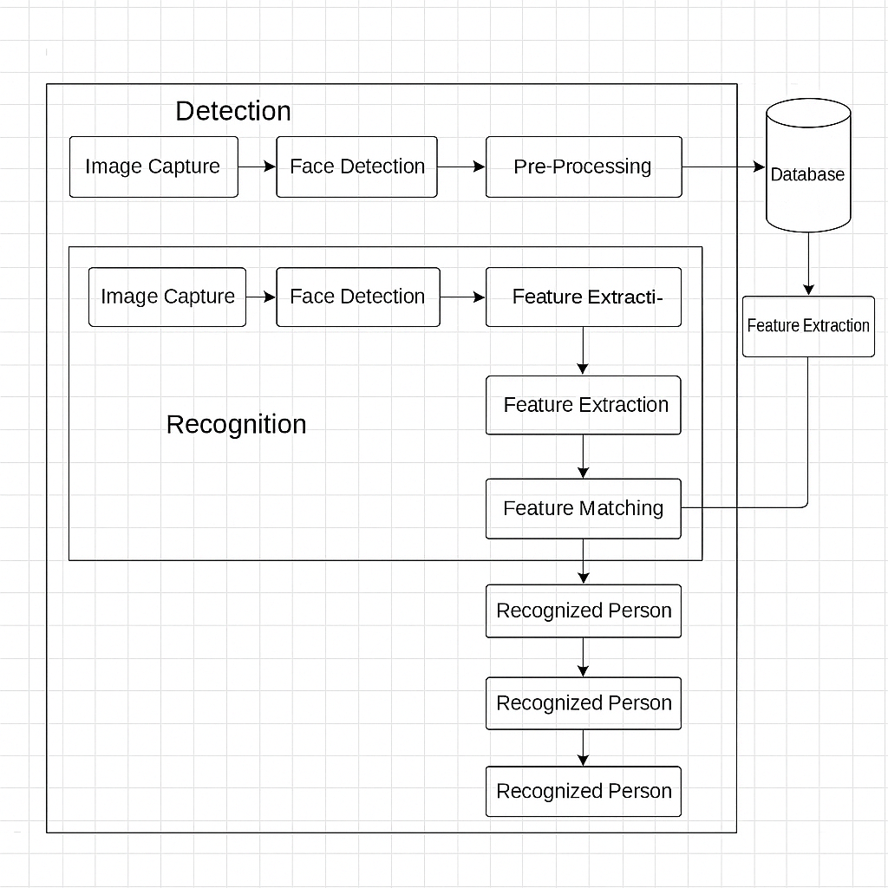
SYSTEM ARCHITECTURE

Slide 14
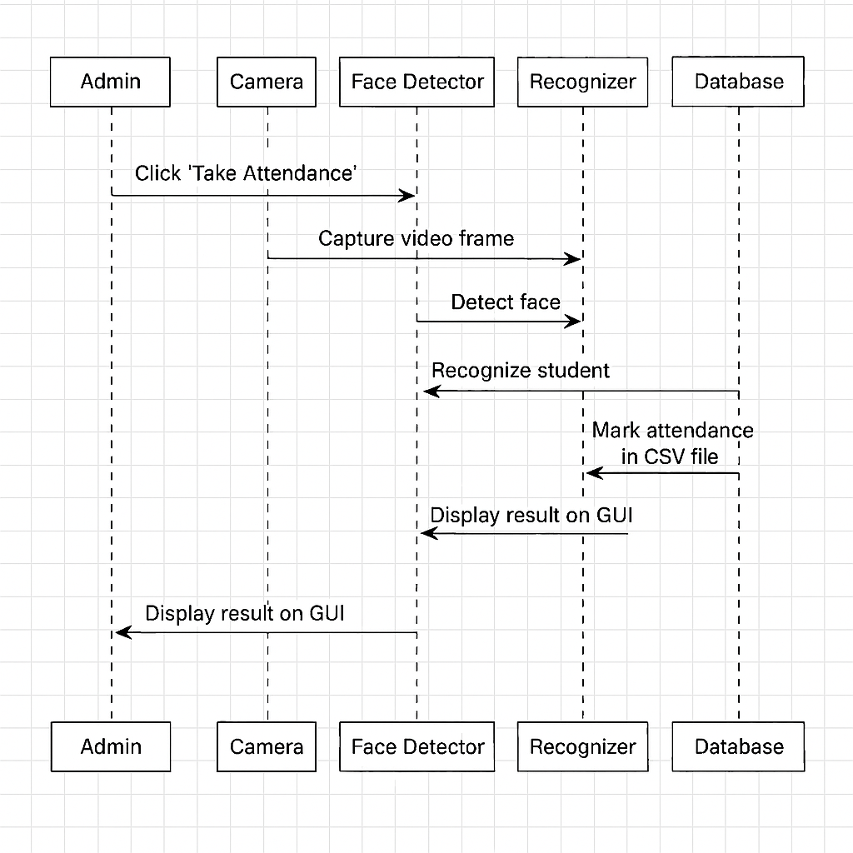
SEQUENCE DIAGRAM

Slide 15
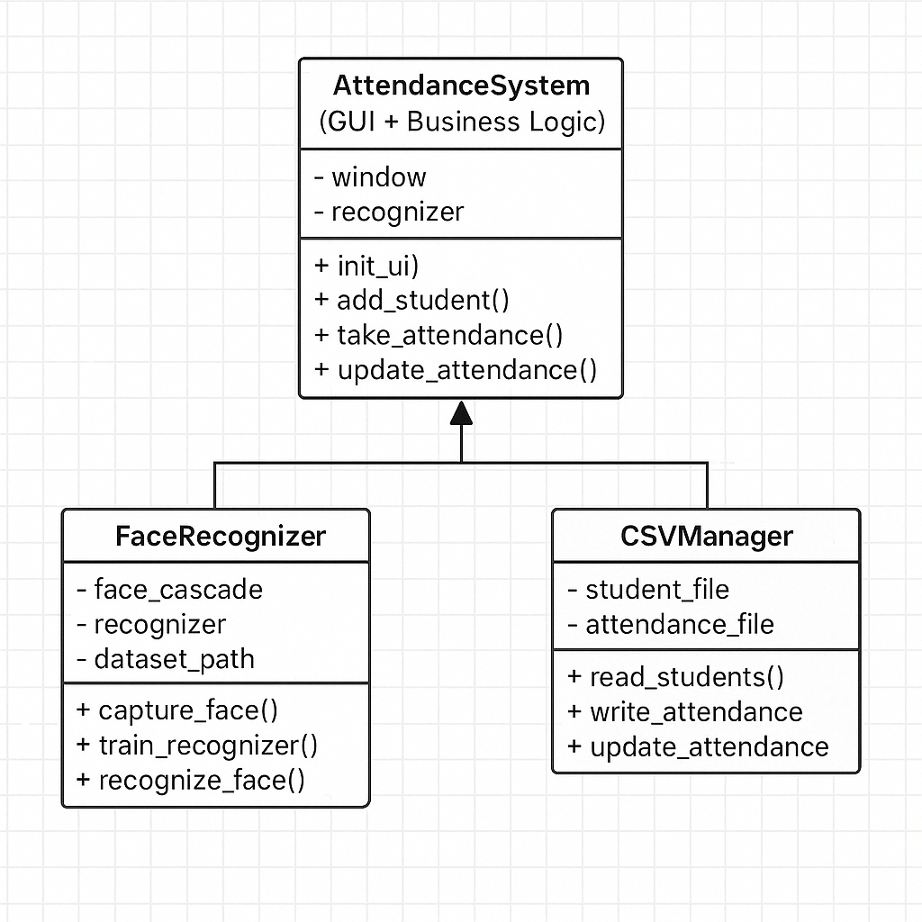
CLASS DIAGRAM

Slide 16
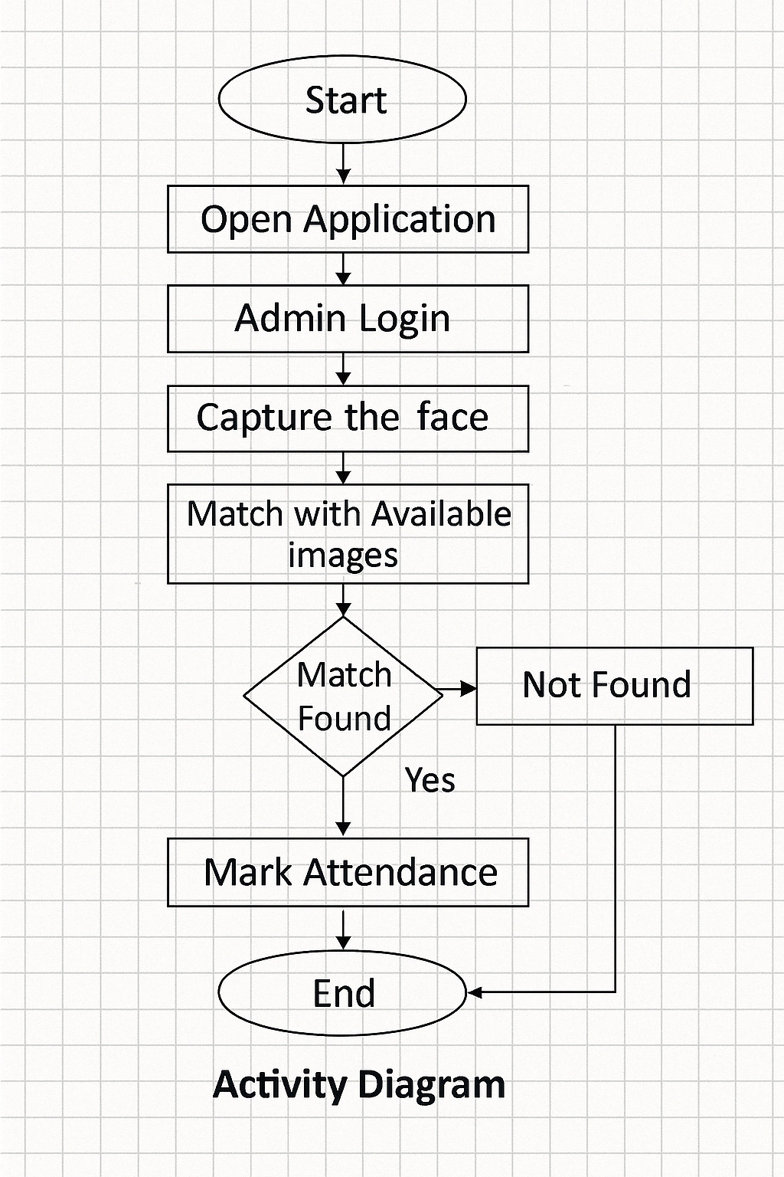
ACTIVITY DIAGRAM

